Slide 1
European Citizenship ERASMUS+ "YOGIES" Survey
CZECHIA

Slide 2
Responses
Students: 212 (15 to 20 years old)

Slide 3
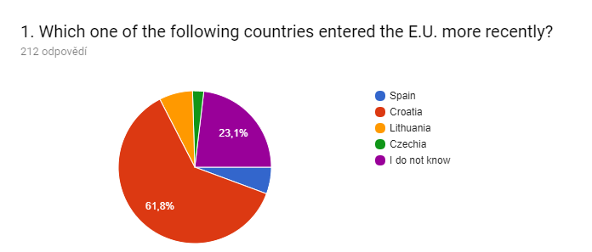

Slide 4
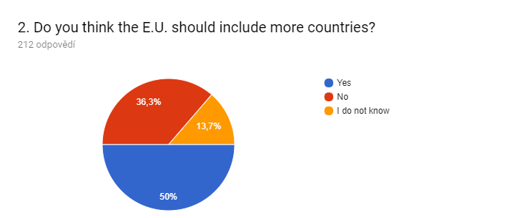

Slide 5
3. Select the name of the countries that were among the very first E.U. founding countries.
France (174)
Italy (96)
Luxembourg (93)
The UK (86)
Many also added the Netherlands, Belgium and Germany (correct)

Slide 6
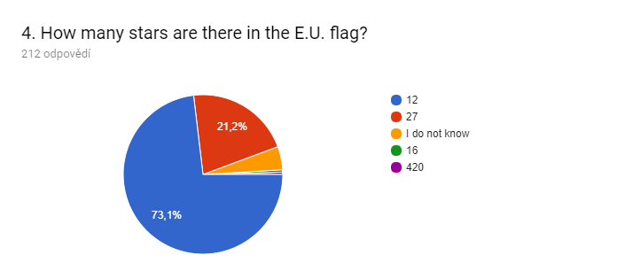

Slide 7
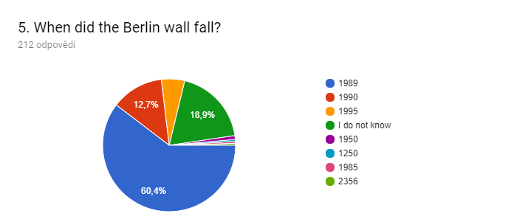

Slide 8
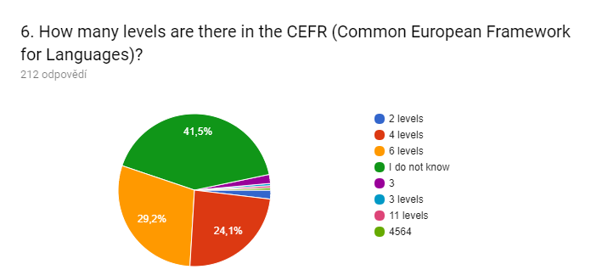

Slide 9
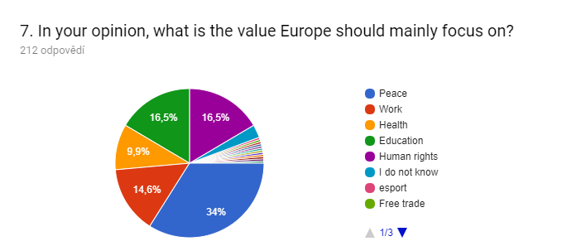

Slide 10
8. What other values should Europe mainly focus on?
Common responses:
peace
human rights
immigration
education
healthcare

Slide 11
9. In which of the following European countries has the Euro not been introduced yet?
Czechia (193)
Latvia (40)
Lithuania (27)
Ireland (24)
Some added other correct answers: Poland, Sweden, the UK, Hungary, Denmark...

Slide 12
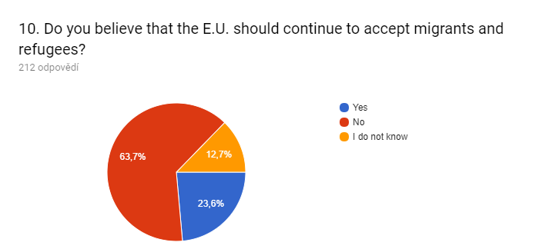

Slide 13
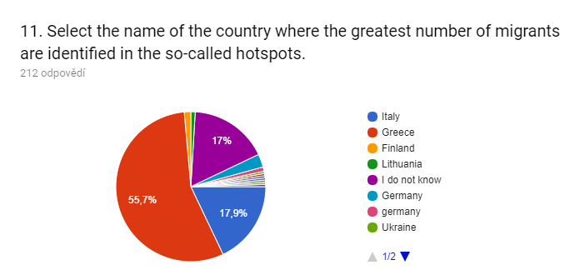

Slide 14
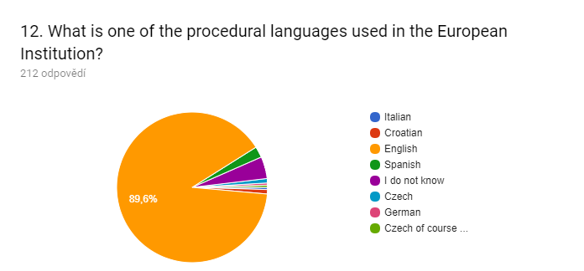

Slide 15
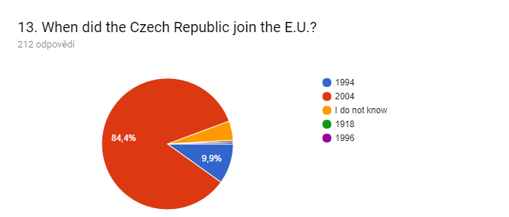

Slide 16
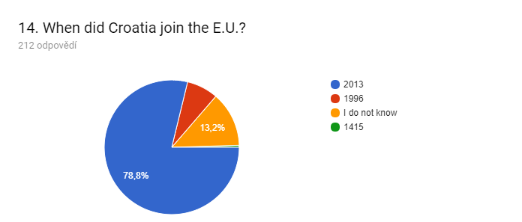

Slide 17
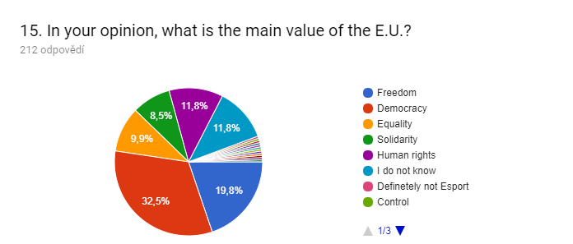

Slide 18
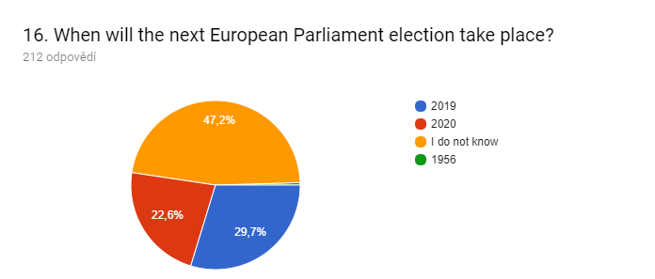

Slide 19
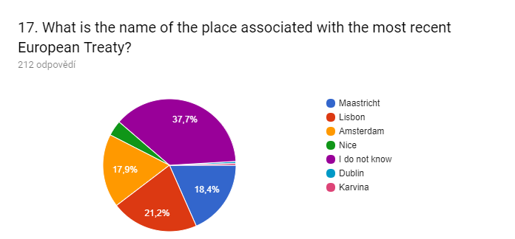

Slide 20
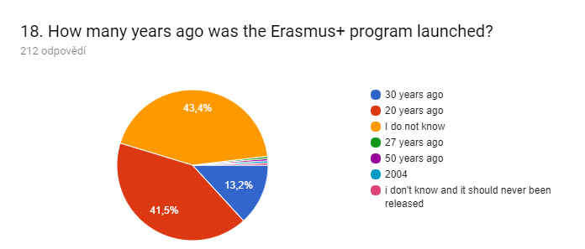

Slide 21
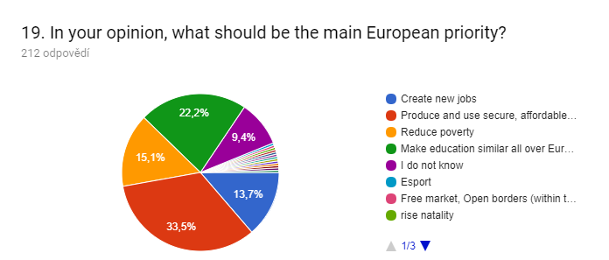

Slide 22
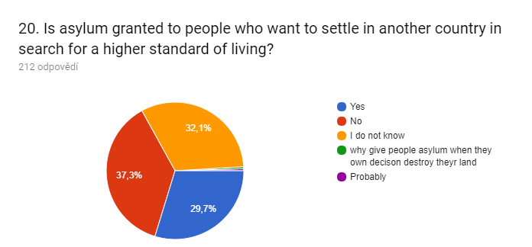

Slide 23
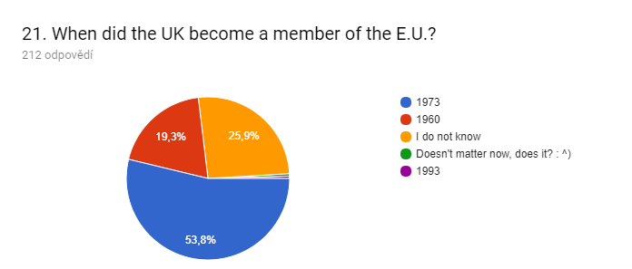

Slide 24
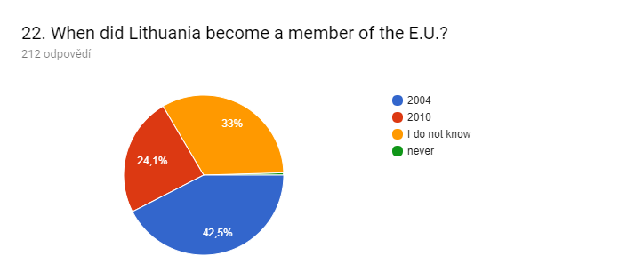

Slide 25
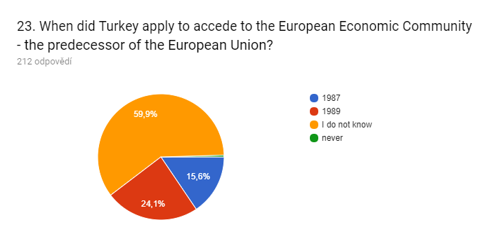

Slide 26
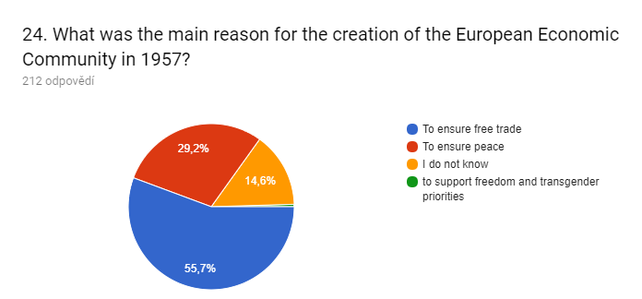

Slide 27
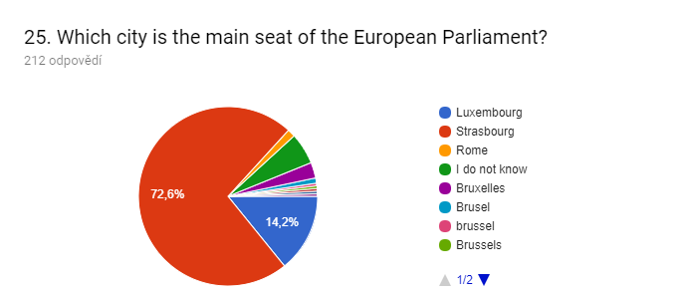

Slide 28
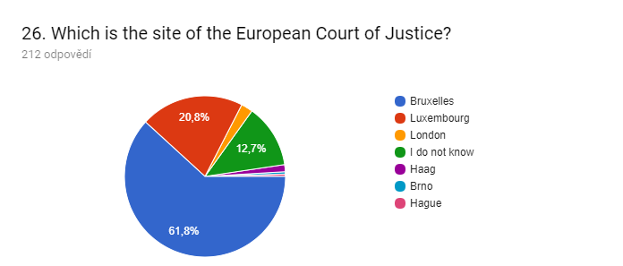

Slide 29
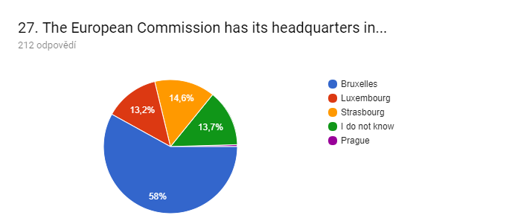

Slide 30
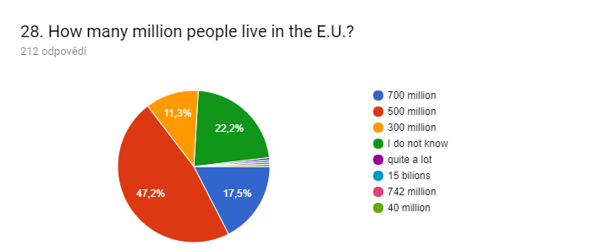

Slide 31
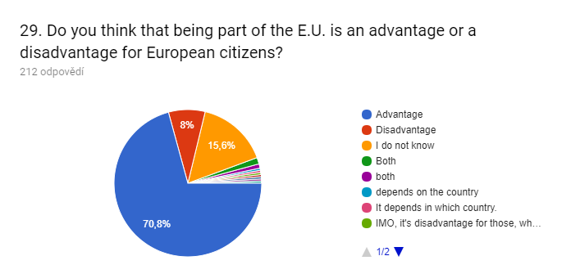

Slide 32
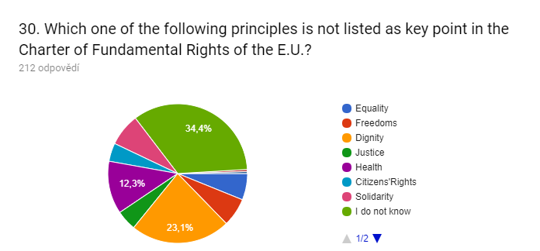

Slide 33
31. What do you think are the main advantages of being part of the E.U.?
freedom
money
freedom of movement
educational projects

Slide 34
32. What do you think are the main disadvantages of belonging to the E.U.?
immigration quotas
legislation
limited sovereignty
Euro

Slide 35
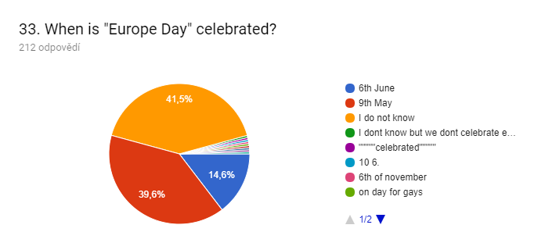

Slide 36
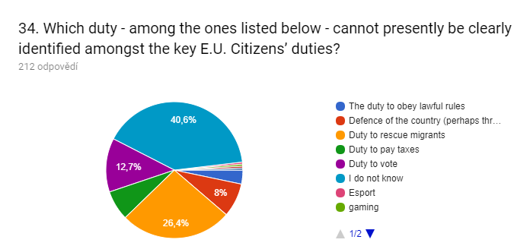

Slide 37
Thank you for your attention.

