Slide 1
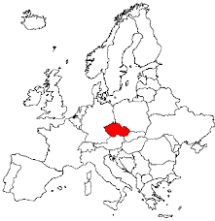
Welcome to
Czechia

Slide 2
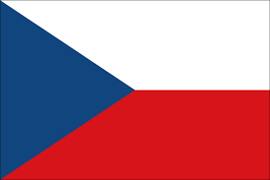
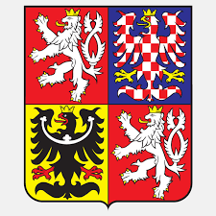
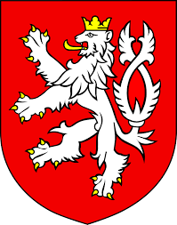
Basic Facts about the Czech Republic
Flag of the Czech Republic
Czech State Emblem
Flag of the President
Small State Emblem

Slide 3
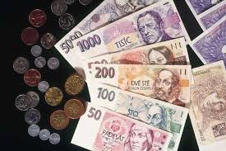
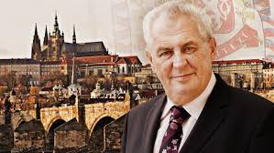
Basic facts about the Czech Republic
Area: 78,864 km²
Population: 10,553,843
Official language: Czech
Political system: Parliamentary republic
Head of State: President - Miloš Zeman
Currency: 1 Czech crown
Capital: Prague
Anthem: Where is my home
Administrative division: 14 regions
Member of organizations: EU, NATO…

Slide 4
Basic Facts about the Czech Republic
Czechia is divided into 3 parts and 14 regions
The historical parts are: Bohemia, Moravia, Silesia
Our region: Moravian-Silesian Region

Slide 5
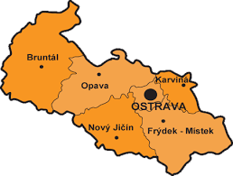
Moravian-Silesian Region
… divided into 6 districts:

Slide 6
Karviná
Divided into 9 boroughs
Spa, university,
Industry
Slovak, Polish, Roma minorities
Problems: petty crime, gambling, population outflow, air pollution

Slide 7
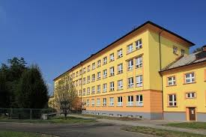
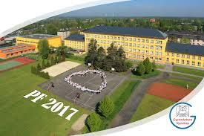
Gymnázium, Karviná, allowance organisation

Slide 8
Gymnázium Karviná
a grammar-school type of a secondary school
4 years or 8 years, from 15 (or 11) to 19, final exams (maturita)
All students have to study English + one more language: French, German, Russian or Spanish.
The students can also visit Austria, England, France, Spain, Switzerland.

Slide 9
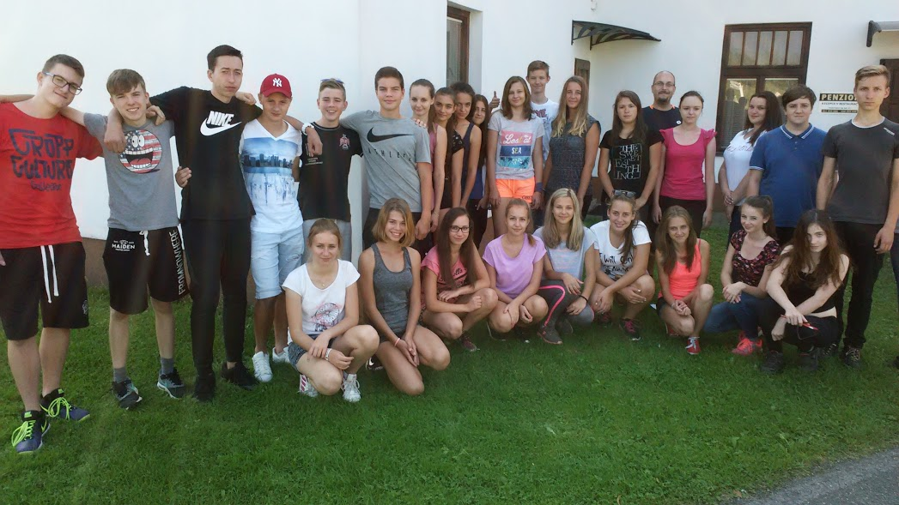
Gymnázium Karviná - our class 1.B

Slide 10
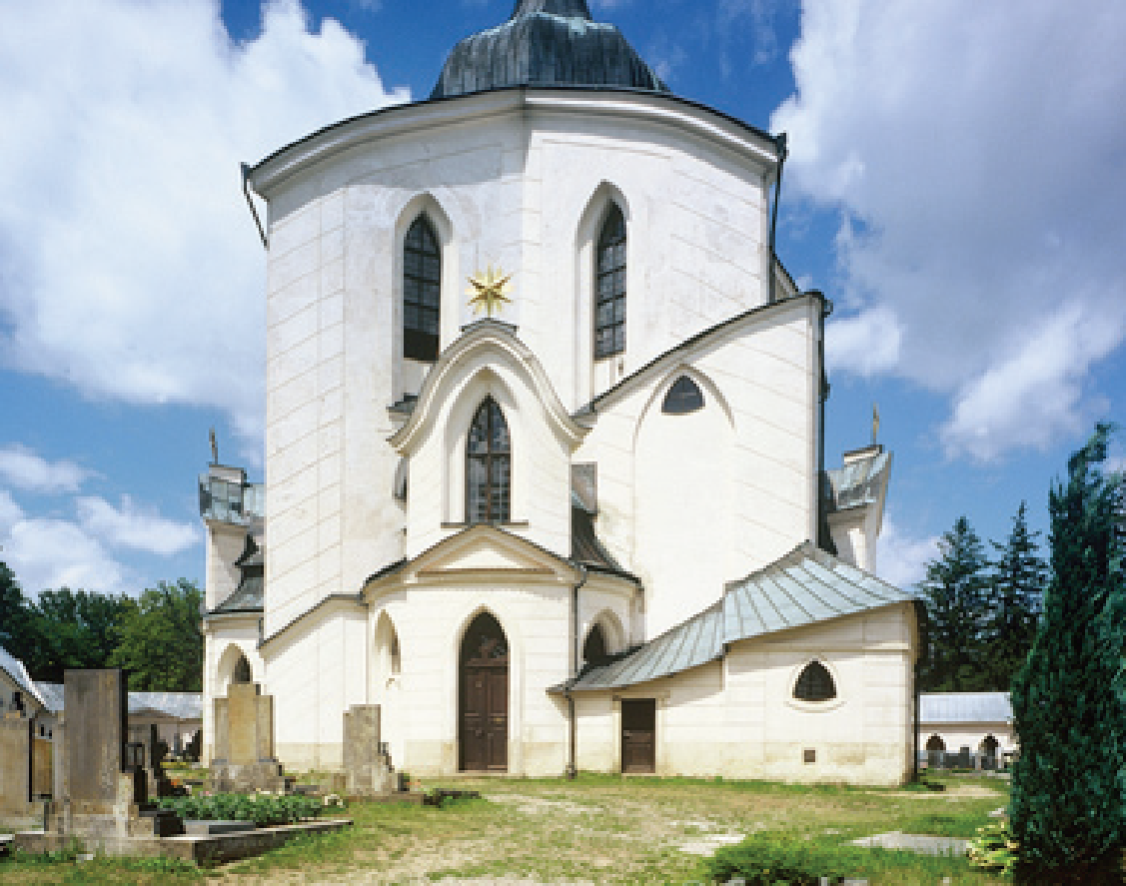
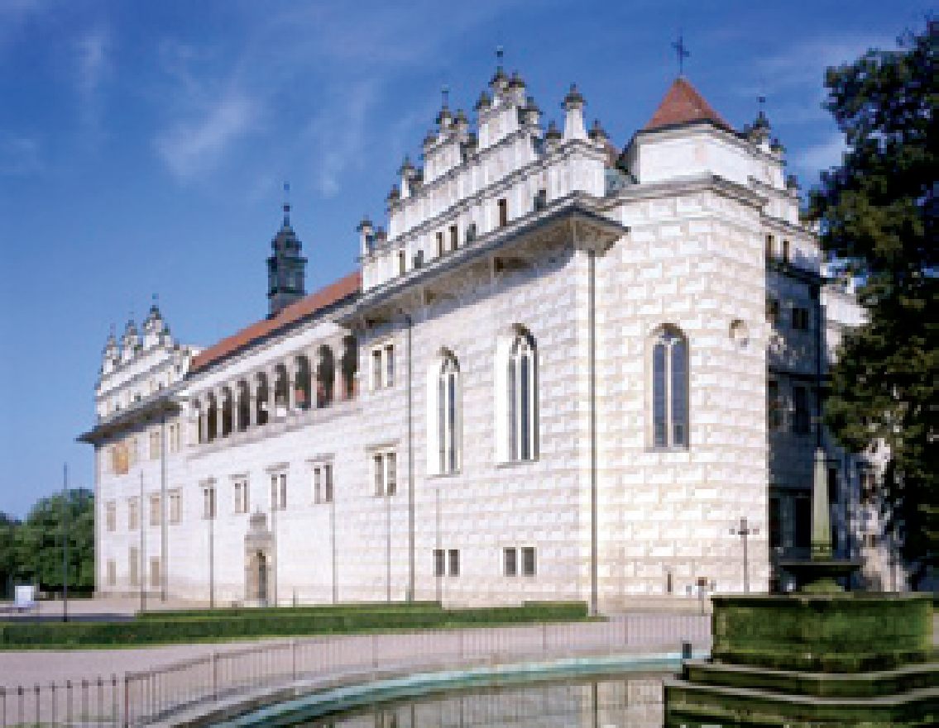
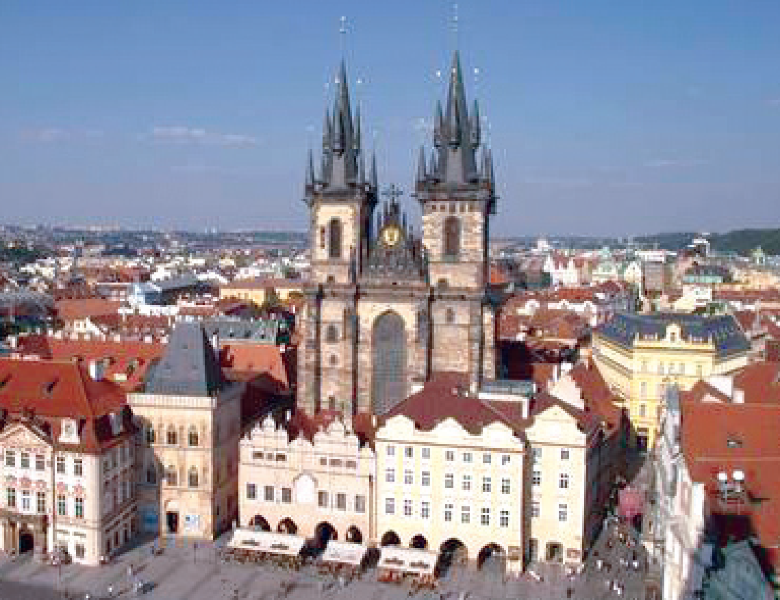
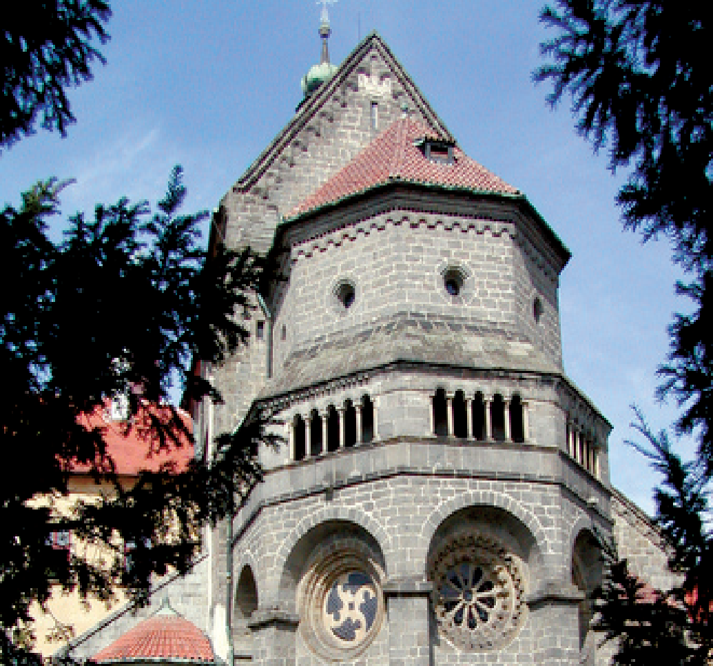
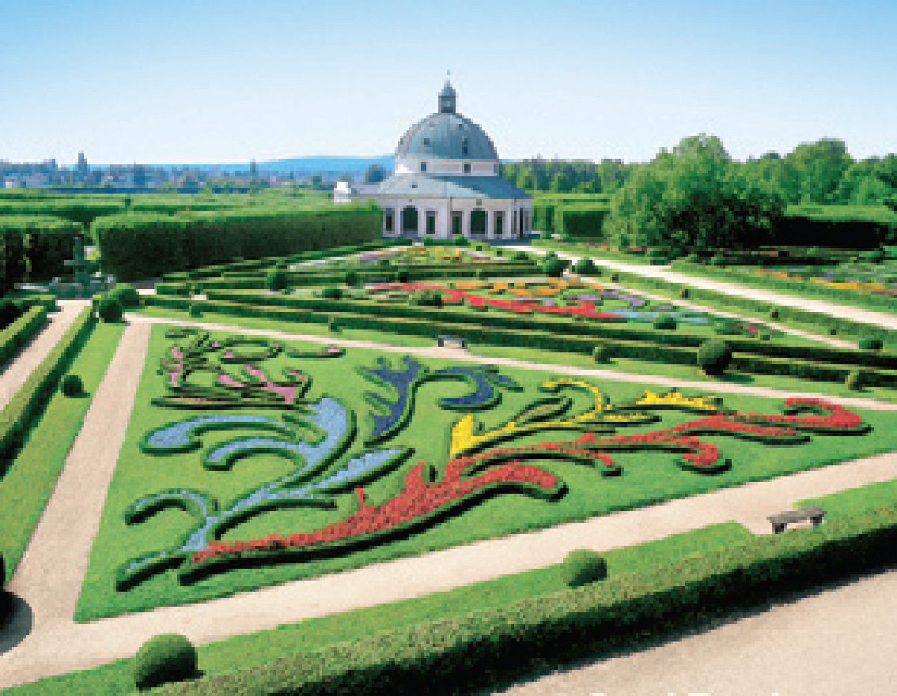
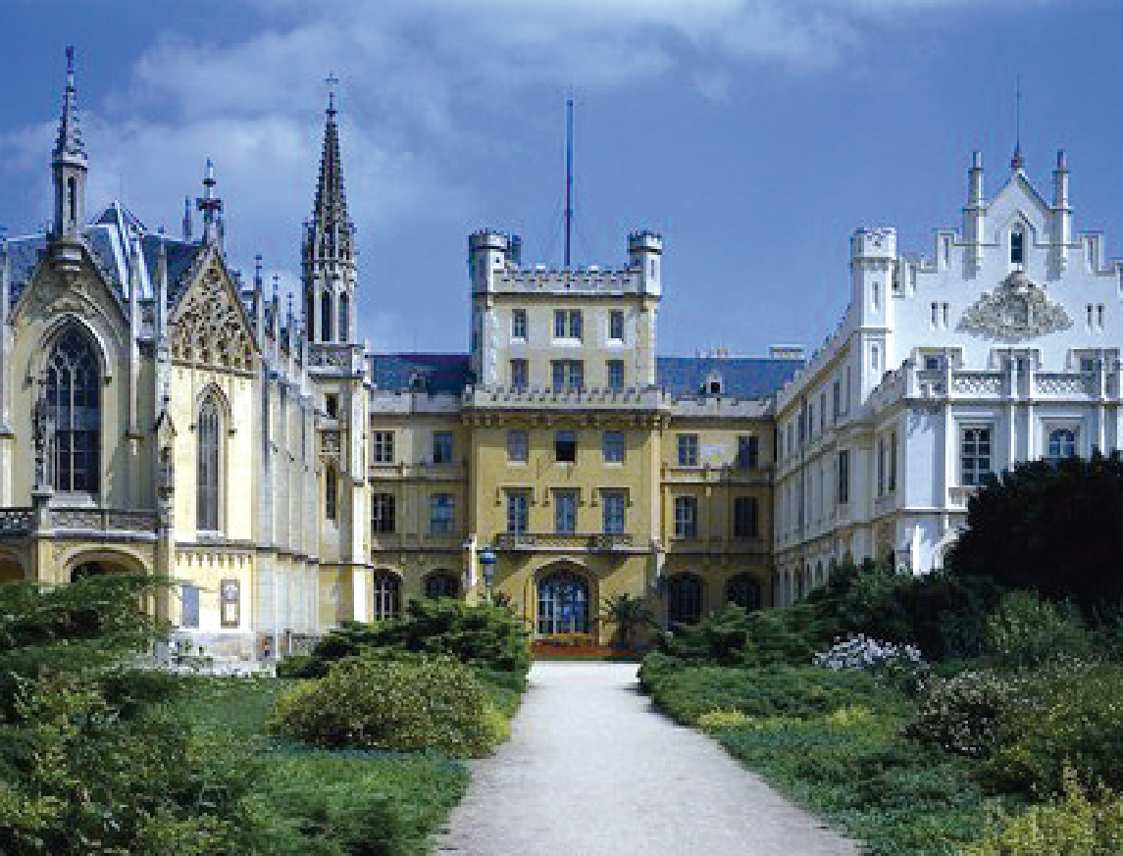
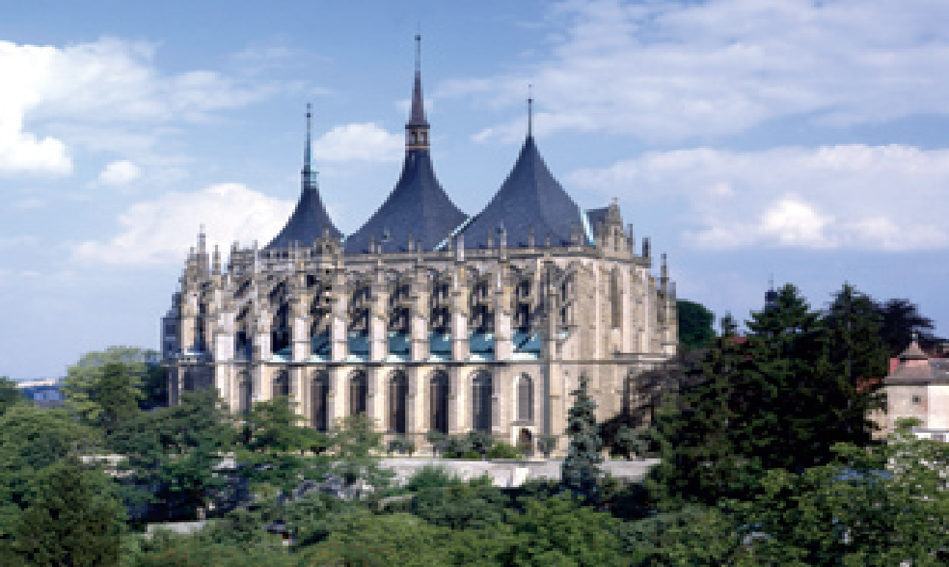
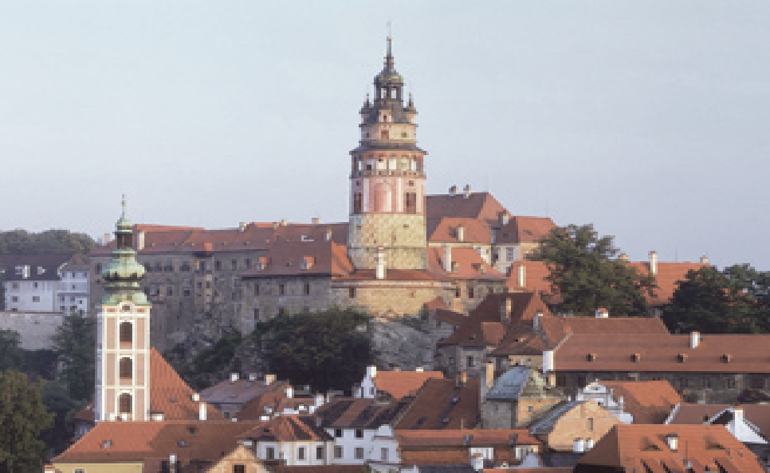
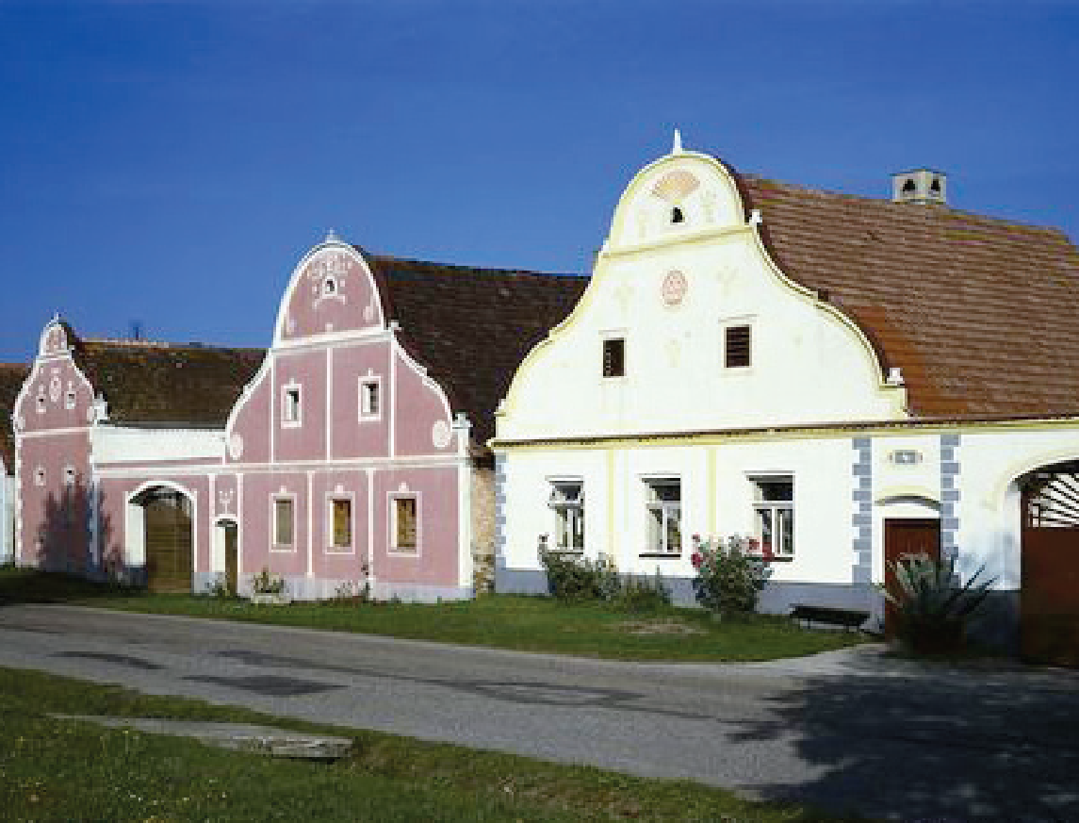
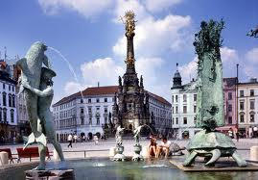
UNESCO sights in the Czech Republic

Slide 11
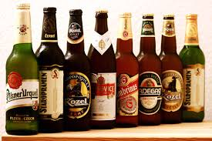
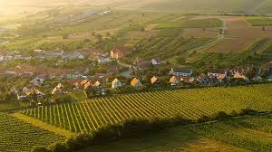
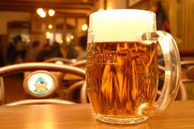
National drinks
Beer
Wine

Slide 12
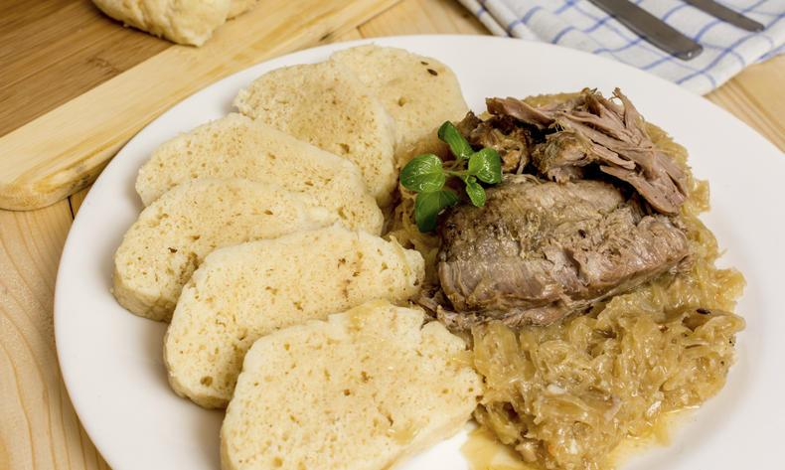
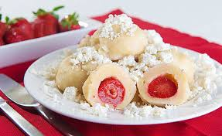
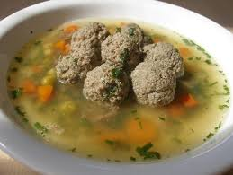
National food
Pork-dumpling-cabbage
Dumplings with fruits
Soup with liver meatballs

Slide 13
Thank you for your attention

