Slide 1
American literature III
VY_32_INOVACE_15-14
From WWI to WWII

Slide 2
The USA and 20th century
progress in industry – more powerful than ever
involved in both world wars
faced with economic problems
fighting for civil rights
impact on modern American literature
WWI influenced the post – war generation of writers
= „The Lost Generation“
artistic level of Amer. literature
short story brought to perfection

Slide 3
ERNEST HEMINGWAY
1899 - 1961
Life:
second of six children of an artist and a doctor
father: hunting, fishing = courage, endurance – topics / + war, bullfighting/
travelling: Spain, Africa, skiing too
depressions, suicide
Jobs:
reporter
WWI – Red Cross ambulance driver
WWII – war correspondent
participation in the liberation of Paris

Slide 4
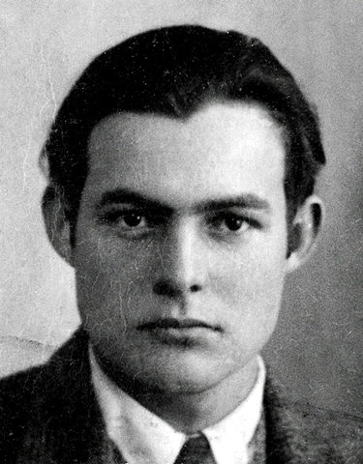
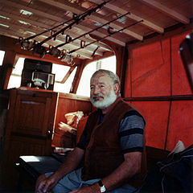
Ernest Hemingway
Autor: neznámý, Název: Ernest Hemingway 1923 passport photo.TIF.jpg
Zdroj: http://en.wikipedia.org/wiki/File:Ernest_Hemingway_1923_passport_photo.TIF.jpg
Autor: neznámý, Název: Ernest Hemingway 1950.jpg
Zdroj: http://en.wikipedia.org/wiki/File:Ernest_Hemingway_1950.jpg

Slide 5
Hemingway`s work
The Sun Also Rises / Fiesta
A Farewell to Arms – WWI, Catherine(nurse) and Henry(ambul. driver)
The Green Hills of Africa
For Whom the Bells Tolls – Spanish Civil War, Robert Jordan, WWII, Robert Jordan is an American who travels to Spain to oppose the nationalist forces of Fran. Franco
F
The Old Man and the Sea – after WWII, Cuban fisherman Santiago,
theNobel Prize 1954ranco

Slide 6
WILLIAM FAULKNER
1897 - 1962
a great Am.prosodist, described the life of the South, naturalistic fiction
The Sound and the Fury - chaotic, difficult, 4 days, between wars
As I Lay Dying

Slide 7
FRAN. SCOTT FITZGERLAD
1896 - 1940
Lost Generation`s writer,
representative of “Jazz Age”
Great Gatsby – Gatsby – psychological effect of wealth - unhappy, no love, lies, hypocrisy, suicide, one friend Nick

Slide 8
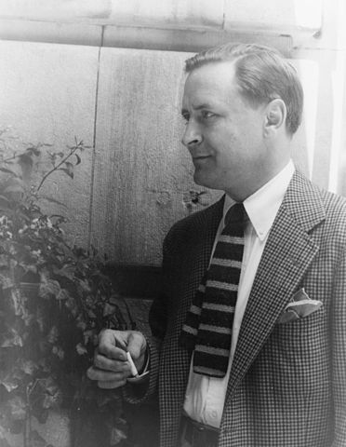
Fr. Scott Fitzgerald
Autor: Carl van Vechten
Název: Francis Scott Fitzgerald 1937 June 4 (2) (photo by Carl van Vechten).jpg
Zdroj: http://cs.wikipedia.org/wiki/Soubor:Francis_Scott_Fitzgerald_1937_June_4_(2)_(photo_by_Carl_van_Vechten).jpg

Slide 9
JOHN STEINBECK
1902 - 1968
great Am. realist- people working in the west, defended the poor, different people, describes the 30`s in America
naturalistic world + sympathy for people
reporter for N.Y.newspaper – didn`t like it, articles, poems, stories, novels - Nobel Prize 1962
Of Mice and Men – two homeless who are looking a job on a farm: Lennie and George /friendship, racism
The Grapes of the Wrath – Joad family (Tom, Casy, …)from Oklahoma- to California

Slide 10
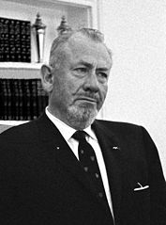
John Steinbeck
Autor: neznámý,
Název: JohnSteinbeck crop.JPG
Zdroj: http://cs.wikipedia.org/wiki/Soubor:JohnSteinbeck_crop.JPG

Slide 11
THEODOR DREISER
1871 – 1945
criticism of Amer.society - carrier, wealth, Amer. dream
American Tragedy
Clyde Griffith – desire for wealth, women
a poor farm girl Roberta
another richer girl
pregnancy, troubles, murder, death penalty

Slide 12
POETRY
modernism:
T.S.Elliot - ‘The Waste Land’ – reaction to WWI, helpelessness against death
Nobel Prize
E. Pound – one of the best poets at those times
Chinese liter, Italy, Mussolini, fascism, mental home
Carl Sandburg – Chicago Renaissance
‘Biography of A.Lincoln’
‘ Chicago’

Slide 13
Thank you for your attention.
Autor DUM: Mgr. Darina Sikorová

